Slide 1

Welcome to the training programme for present and future education and health leaders
Building healthy and resilient schools in the post-Covid era
QR code and link Slido
https://bit.ly/resilient-schools
You can prepare the session by copying the links of flashing the QR codes

Slide 2
Key factors to build healthy and resilient schools in the post-Covid era
Preventing a lost decade
Pr. Didier Jourdan
University of Clermont-Auvergne, France

Slide 3
Training programme for education and health leaders
Objectives
The main goal of the training programme in school health promotion is to contribute to the capacity building of education and health leaders and further professionalization of the people contribution to health promotion in order to build healthy and resilient schools.

Slide 4
Training programme for education and health leaders
Three online sessions on:
Thursday 20 October from 02:00 pm to 04:00 pm on Webex and on-site at NTNU
Friday 21 October from 02:00 pm to 04:00 pm on Webex and on-site at FJU
Tuesday 1st November from 01:30 pm to 02:00 pm Webex link (NB: for people from the 4 counties involved in the policy design the meeting on-site will be held between 13:20 and 16:00)

Slide 5
Training programme for education and health leaders
All attendants will have access to a drive with all the relevant documents
They are invited to participate through the use of Slido
QR code and link Slido
QR code and link Drive
Tell us who you are

Slide 6

Key factors to build healthy and resilient schools in the post-Covid era
The multidimensional impact of the Covid crisis on children and young people
A widening of inequalities
The central role of Mental Health Promotion in the post-covid era
Underpinning principles of the HPS approach
Five key questions for the translation of HPS principles in the real life

Slide 7
Key factors to build healthy and resilient schools in the post-Covid era
The multidimensional impact of the Covid crisis on children and young people
A widening of inequalities
The central role of Mental Health Promotion in the post-covid era
Underpinning principles of the HPS approach
Five key questions for the translation of HPS principles in the real life

Slide 8
Impacts of the Covid crisis on health and education of children and young people
Major impact on education: learning loss in core subjects, declines in college enrolment, increase in socioeconomic skills gap...
Impact on physical, mental and social development and wellbeing
Restricting access to school meals, health visiting, social care and school-based vaccinations disproportionately impact children from disadvantaged backgrounds.
Haeck And Lefebvre 2020, Parnham et al., 2020, Kahfeld et al. 2020, Viner et al. 2021

Slide 9
Key factors to build healthy and resilient schools in the post-Covid era
The multidimensional impact of the Covid crisis on children and young people
A widening of inequalities
The central role of Mental Health Promotion in the post-covid era
Underpinning principles of the HPS approach
Five key questions for the translation of HPS principles in the real life

Slide 10
A widening of inequalities
Children today are growing up in a world facing multiple crises.
The costs are not affecting all children equally.
The most marginalized and vulnerable are hurt the most and vast disparities in health, education, mental health, poverty and migrants remain
"It's between six months and a year of waiting": shortage of staff in child psychiatry jeopardises the care of children

Slide 11
A widening of inequalities
Socioeonomic inequalities
Inequalities in internet (2.2 billion children and young people aged 25 years or less do not have an internet connection at home)
Children have witnessed more ads for unhealthy products in the media during the pandemic
Disruption of violence prevention and response services
Disruption in family planning
…

Slide 12
Key factors to build healthy and resilient schools in the post-Covid era
The multidimensional impact of the Covid crisis on children and young people
A widening of inequalities
The central role of Mental Health Promotion in the post-covid era
Underpinning principles of the HPS approach
Five key questions for the translation of HPS principles in the real life

Slide 13

Creating the conditions for the development of all children and young people
PROTECTION
EDUCATION

Slide 14
Changing world for children and young people
Post-covid damage and recovery but also …
Global megatrends
  Change in planetary ecosystems
  Digital technologies
  Urbanisation
  Nutrition transition
  Globalized commercial interests
  Demographic changes
  War and conflict
Children and young people Most affected
Children and young people Key agent of response
Jon Klein 2022

Slide 15
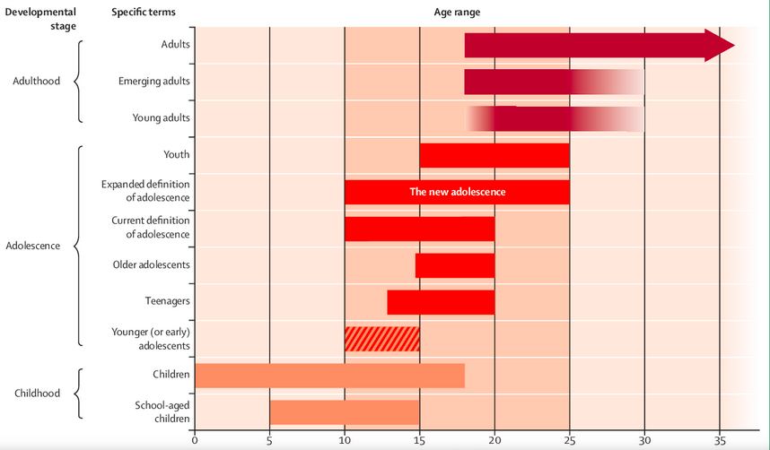
A developmentally appropriate approach

Slide 16
Changing world for children and young people
A new adolescence
Mental health and NCDs
Empowerement and participation
Young people as key agent of change
Unifying themes for young people: environment, health and well being
Jon Klein 2022

Slide 17
Children and adolescents today
One cannot implement public health measures without, or indeed against, the goodwill of the population.
Children and young people are not the “problem”, they are part of the solution!

Slide 18


Slide 19

Design developmentally appropriate policies
Applying a youth and intergenerational lens in crisis response and recovery measures
Supporting young people initiatives
Build back stronger by ensuring quality education, protection and good mental health for every child
Invest in the mental health and well-being of children and young people.
Build resilience to better prevent, respond to and protect children from crises
Take urgent action to protect children from climate change and slow the devastating rise in global temperatures
…

Slide 20
Key factors to build healthy and resilient schools in the post-Covid era
The multidimensional impact of the Covid crisis on children and young people
A widening of inequalities
The central role of Mental Health Promotion in the post-covid era
Underpinning principles of the HPS approach
Five key questions for the translation of HPS principles in the real life

Slide 21
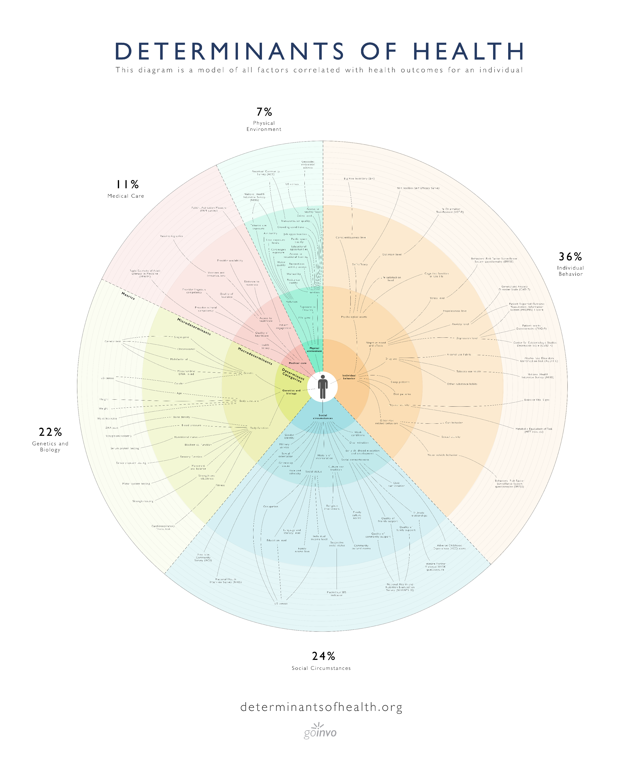
Health promoting schools
Children and young people spend 40 % of their waking hours at school
Influencing all the determinants of health: school as a setting, school as a place where people learn
Making every school a foundation for healthy and resillient lives

Slide 22
What make a difference?
Curriculum Teaching and Learning
School, management health services
Community links and partnerships
Health as an integral part of whole school management and planning.

Slide 23
The eight global standards for HPS intended to function as a system (WHO)
6. School social-emotional environment
1. Government policies and resources
2. School policies and resources
3. School governance and leadership
4. School and community partnerships
5. School curriculum
8. School health
services
7. School physical environment
Schools are seen as active agents for community development.

Slide 24
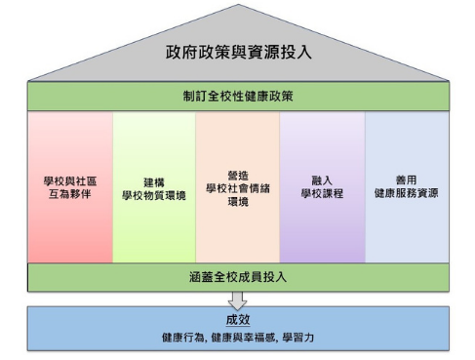
Taiwan HPS 3.0

Slide 25
Well designed programmes contribute to reduce health inequalities
Results: universal approaches
Programmes focused on meal/fruit supply, universal access to services, physical activity promotion, obesity prevention and dental health. It seems the positive influence in easier to explore when the outcomes are related to basic need than for complex outcomes.
Programmes targeting school environment are the most effective.
Results: targeted approaches
Most of the studies is focused on socioeconomic inequalities. Some studies investigated the potential contribution of health related interventions in school on handicap or gender.
Jourdan 2019

Slide 26
Cost-effectiveness and return on investment of school-based health promotion programmes
ROI through the avoidance of direct healthcare costs related to the treatment and management of chronic diseases would be 824% for comprehensive programmes, 465% for multicomponent interventions, and 484% for PE curriculum modification interventions.
Whereas each examined intervention types showed favourable economic benefits, CSH programmes appeared to be the most cost- effective and to have the highest ROI.
The multiplier impact of investment on total community activity up to two years was 5.07; 1.60 attributable to school, and 2.47 to wider community.
Meta-analysis of the effectiveness of feasible, acceptable, and sustainable programmes.
Garden andkitchen classes
Ekwaru et al. 2021

Slide 27
Key factors to build healthy and resilient schools in the post-Covid era
The multidimensional impact of the Covid crisis on children and young people
A widening of inequalities
The central role of Mental Health Promotion in the post-covid era
Underpinning principles of the HPS approach
Five key questions for the translation of HPS principles in the real life

Slide 28
To create changes in the whole school… One size does not fits all!
School operates in its own specific context, which relates to its specific circumstances and characteristics, such as the social, political, economic, and physical environment;
This means that the needs, wishes and opportunities vary across schools. It also means that a school acts in a unique way and can react differently to HP interventions.
Implementing the HPS approach in a school, can never be seen apart from its context. In each school the HPS principles need tailored translation to create effective and sustainable actions that fit the specific context.
The real life!

Slide 29

Supporting the leaders in the change management process
Improving the school policies
Enacting an approach $≠$ Implementing a programme

Slide 30
Five key questions for education and health leaders

Slide 31
The involvement of stakeholders in the decision-making and implementation of the HPS approach
Top-down process in which an intervention package is mainly developed, implemented with high fidelity and evaluated by people from outside the school, such as health professionals. This top-down process can be characterized by the optimal use of expert knowledge, skills, and experiences, and can lead to more evidence-based HP interventions.
Bottom-up decision making and implementation of the HPS approach. This means that school staff, children, and parents are fully involved in the development, implementation and evaluation of the HPS approach. The bottom-up process can be characterized by creating more ownership, empowerment, and engagement of the people in the school, and can lead to HP interventions that are better adapted to the context and are more sustainably implemented.

Slide 32
The core-components of the HPS approach that are targeted
Navigating towards the left side of the spectrum implies that the implemented intervention package primarily addresses one core-component, e.g., school’s physical environment or students ans staff’s mental health post-Covid.
Navigating towards the right side of the spectrum implies addressing multiple core-components. This may be useful when a school wants to deal with health problems that are highly wicked due to complex interactions between personal and environmental determinants.

Slide 33
Adopting existing or developping new HP interventions resulting from the HPS approach
Navigating towards the left side of the spectrum includes the adoption of existing HP interventions and adaptation to the new context.
Navigating towards the right side of the spectrum includes the development of new HP interventions, adapted for a specific school context. This may be more time-consuming, but can create HP interventions that are more targeted to the needs and wishes of the school members, and the physical, social and political context of the school.
The position on this spectrum is often dependent on the available resources, time and support within and outside the school.

Slide 34
Disruptiveness of the HP interventions as part of the HPS approach
A school can decide to implement small non-disruptive HP interventions in the school system. This is characterized by keeping the stability in the school and continuing the way of working as much as possible.
Navigating towards the right side of the spectrum implies creating a positive disruption by introducing large disruptive HP interventions. These type of HP interventions may trigger the school system to self-organize a newer state of stability, in which the school’s norms may shift focusing more on health and well-being and thereby creating momentum for additional HP interventions.

Slide 35
Implementing HP interventions within the school curriculum or in addition to core curriculum
An ‘add-on strategy’ describes implementing HP interventions in addition to core curriculum obligations. This may be less complex, but school staff often perceive it as an additional task to their core responsibilities.
Navigating towards the right hand side of this spectrum describes an ‘add-in strategy’. The development and implementation of these types of HP interventions is more complicated, however they are more likely to become part of curriculum-based educational activities without reducing time from the core curriculum obligations.

Slide 36
Conclusion
Making every school a foundation for healthy and resillient lives is a matter of improving daily practices that promote health.
The challenge, in the various educational contexts, is to engage education professionals and support them in developing management and teaching practices that positively affect the determinants of health of their students.
Health professionals can position themselves as catalysts for structural change, as they have many opportunities to advocate for, and participate in, the intersectoral implementation of reforms and innovations in school systems to promote the health of all students.

Slide 37
Key factors to build healthy and resilient schools in the post-Covid era
Preventing a lost decade
Pr. Didier Jourdan
University of Clermont-Auvergne, France

